Slide 1
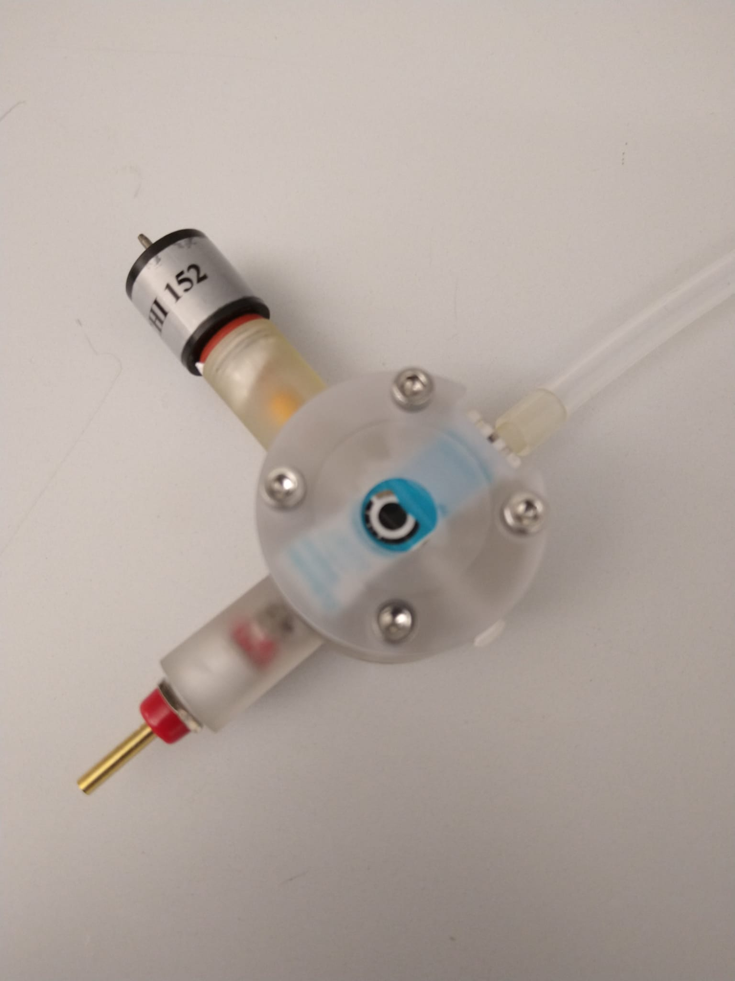
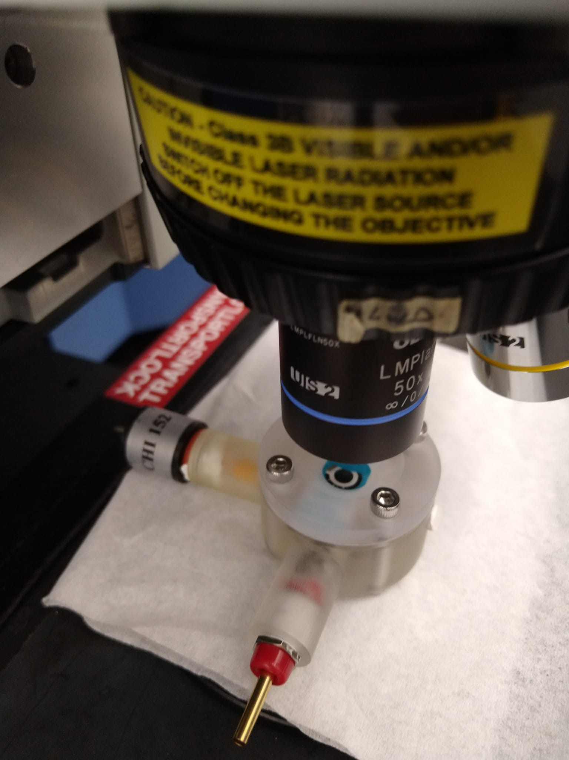
a
b
RE: Hg/HgO electrode
Stainless steel bolts
RE: Hg/HgO electrode
Confocal Raman microscope
Cell body
WE: SPE
Cell body
50x objective
CE: Ni foam electrode
CE

Slide 2
a
c
b

Slide 4
a
b
c
d

Slide 5
b
a

Slide 6
a
b

Slide 7
b
a

Slide 8
a
b

Slide 9
a
b
c
d

Slide 10
a
b
c
d

Slide 11
a
b
c
d

Slide 12
a
b
c
d

Slide 13
a
b
c
d

